Slide 1

APHUNZIRE E-LEARNING PLATFORM

Slide 2

Agenda
Introduction
01
Team
02
Project Background
03
Project Goals and Objectives
04
Project Scope
05
Methodology
06
Project deliverables
07
Timelines
08
Resource Requirments
09
Progress Update
10
Next Step
11

Slide 3

INTRODUCTION
Section title
E-learning in Malawian education fosters equal education by eliminating access barriers and providing equal opportunities for all students, regardless of location, physical ability, or environmental challenges, thereby promoting equal opportunities, empowerment, and a more equitable educational system.

Slide 4

Project Background
In Malawi, students in remote areas struggle to access education, particularly during challenging weather like the rainy season. Physical disabilities further hinder attendance at traditional schools. Thus, the development of an online e-learning platform tailored to Malawi is crucial, ensuring equal educational access despite geographical or physical constraints.

Slide 5





People and team
Trojan Mwamlima
project coordinator
trojanjefferson@gmail.com
George kajombo
project manager
kajombohgeorge@gmail.com
Theodore Chilongo
CEO
theodorechilongo@gmail.com
Chikondi Matumula
Team Member
chikondimatumula1994@gmail.com

Slide 6

Project Goals And Objectives
1. Ensure all students have access to Aphunzire E- learning during natural disasters for continuous learning.
2. Implement a feedback system within Aphunzire for teachers to provide timely feedback to students on their progress.
3. Facilitate regular collaborative learning sessions among students through the interactive features of Aphunzire.
4. Utilize Aphunzire's monitoring tools to track student progress and evaluate learning outcomes effectively.

Slide 7

Project Scope
1. Features and Functionality
2. User roles and permissions
3. communication and Collaboration tools
4. Security and Privancy
5. Scalability and Performance
6. content Types

Slide 8



Methodology
Agile methodology
Design thinking methodology
scrum methodology
Iterative project approach with short cycles for continuous feedback, fostering teamwork and adaptability for efficient value delivery.
Iterative approach prioritizing user empathy, ideation, prototyping, and testing for innovation. Emphasizes cross-disciplinary collaboration and creative problem-solving.
Team-focused framework emphasizing interactive progress through fixed-duration sprints, with regular meetings for transparency and improvement.

Slide 9
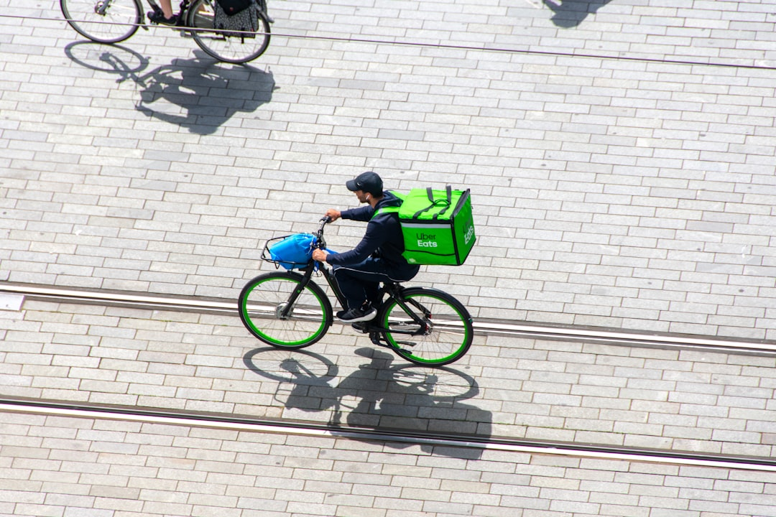
Project deliverables
1. Prototypes
2. Use Case Diagram
3. Sequence diagram

Slide 10
TIMEFRAME/LINES
second week
fourth week
Designing
which involves creating wireframe, prototype, mockups
Monitoring
This step deserves some explanation, too.
first week
third week
fiveth week
Discovering & planning
which involves research, identifying users, functional requirements
Development
which involves of implementing the plaform.
Live collaboration
Give some final context.

Slide 11

Progress Update
1. Admin
ü Authentication
ü Dashboard
ü Calendar of events
ü User logs
2. Teacher
ü Authentication
ü Chart forum
ü Add assignment
ü Add materials
ü Add quiz
3. Student
ü Authentication
ü Chart forum
ü View materials
ü

Slide 12

Next Steps

Slide 13
FUNCTIONAL REQUIREMENTS
User registration and Authentication
Users should be able to create accounts, log in securely.
Students will be able to view and write exercises
Teacher will be able to create learning content, manage classes and students, support students.
Administrator manage users, create school upcoming events, manage content of the system.

Slide 14
NON-FUNCTIONAL REQUIREMENTS
Accessibility
Color and contrast, there will be color combinations that will be accessible to students with color blindness or low vision.
Accessible Assessment, Assessment, quizzes, and exams will be designed to be accessible to all learners for instance text based or oral based.
Maintainability
The system will use Agile methodology with the software process model of incremental and iterative.
There will be comprehensive documentation outlining the course structure, content guidelines, and updating procedures.

Slide 15
NON-FUNCTIONAL REQUIREMENTS CONT…
Efficient
There will be optimization of data processing algorithms and database queries to minimize response time and maximize throughput.
The system will be designed to be scalable, allowing it to handle increase number of concurrent users and growing amount of content without sacrificing performance
Compatibility
Browser compatibility, the platform will compatible with a wide range of web browsers, including popular options such as Google Chrome, Mozilla Firefox, Apple Safari, Microsoft Edge, and opera.
Mobile compatibility, the system will be mobile-friendly responsive, allowing users to access course materials and participate in activities on smartphones and tablets.

Slide 16
USE CASE OF APHUNZIRE

Slide 17
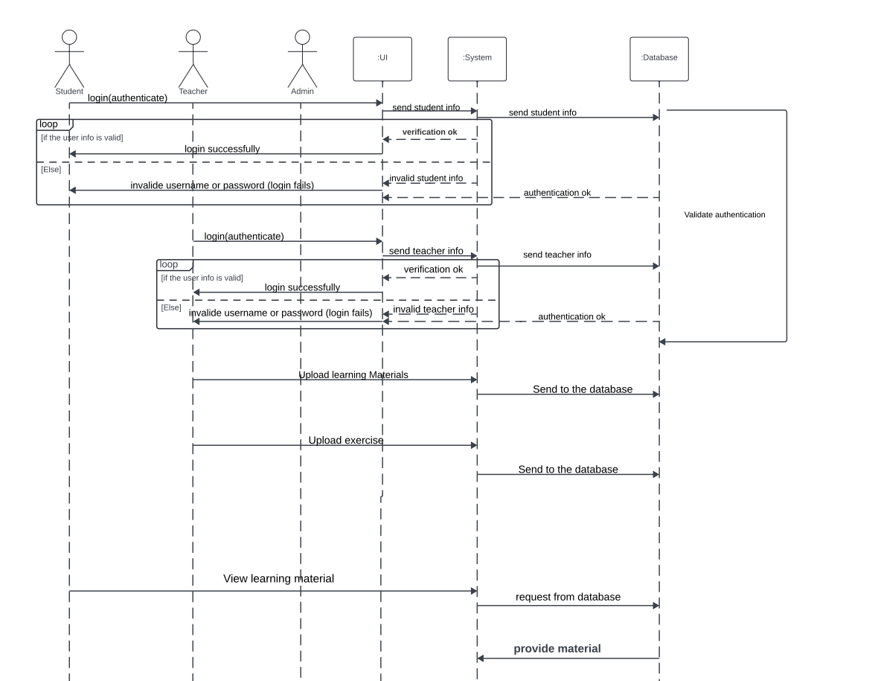
SEQUANCE DIAGRAM

Slide 18
HIGH FIDELITY PROTOTYPE

Slide 19
HIGH FIDELITY CONT…

Slide 20
HIGH FIDELITY CONT…

Slide 21
HIGH FIDELITY CONT…

Slide 22
HIGH FIDELITY CONT…

Slide 23
HIGH FIDELITY CONT…

Slide 24
HIGH FIDELITY CONT…

Slide 25
HIGH FIDELITY CONT…

Slide 26
